Slide 1
Identifying public domain serials in Penn Libraries collections
John Mark Ockerbloom and Rachelle Nelson
Penn Libraries Serials Copyright Research Workshop
May 29, 2020

Slide 2
Why identify public domain serials?
We have lots of serial content in public domain
  But much of it isn’t known to be public domain
  and isn’t available online (either to us or anyone)
Digitized historic texts (e.g. HathiTrust) widely used
  Thanks in part to copyright review & access programs
With copyright information, we and others can make “deep backfiles” of serials available to all
  Both during and after the current health crisis

Slide 3
How we identify works that can be in US public domain
Works with copyrights before 1925
  (You won’t work on serials our catalog says end by then)
Works of the US government
  (You may find some of these; let us know if you do)
Works with unrenewed copyrights before 1964
  (These may include most of the serials you work on)
Works with no claimed copyright before 1989
  (Many non-commercial serials didn’t, so worth checking)
BUT: Works not published in US may be exempt
  (so we ask about foreign & simultaneous US publication)

Slide 4
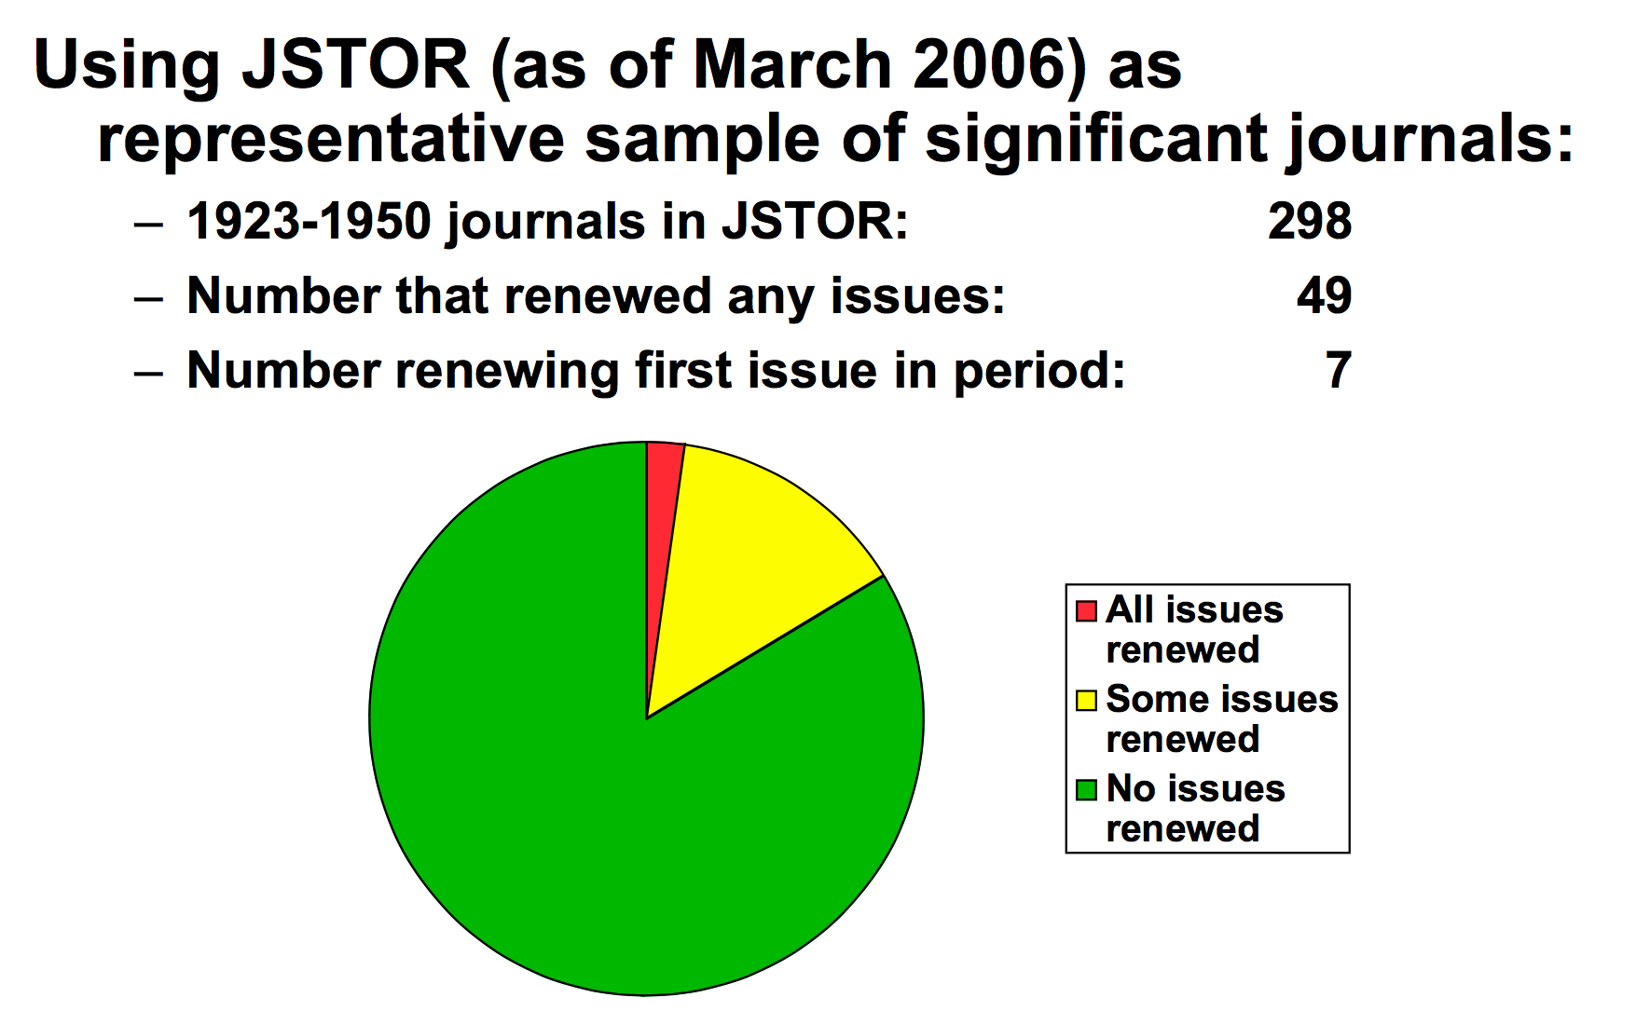
Low renewal rates for most serials

Slide 5
Previous work
(some funded by IMLS)
Inventory of first copyright renewals of serials
  Includes ALL serials published before 1950 with copyright renewals; this project will add more
A guide for using this inventory to copyright-clear historic serial issues and articles
  for digitization, reuse in scholarship, etc.
A linked-data copyright knowledge base
  JSON files linked to Wikidata, free online copies, Wikipedia, rightsholder contacts, contents lists, more

Slide 6
What we’re doing now
Now that we know what serials are under copyright, we’re finding what we have that’s not
We built a table showing serials Penn owns, and what we know about their copyrights and free issue availability
Where we don’t yet have info, you can fill out a questionnaire by doing searches with a web browser and reporting your findings
From your questionnaire answers, we add more JSON files to our knowledge base, add to our first-renewals list, link to Wikidata, etc.

Slide 7
Demo
(Rachelle Nelson)

Slide 8
What happens next
If you return to the table, the serial you worked on will appear with “Pending” where “Unknown” appeared before
Others will double-check, create a JSON file and copyright info page, link it into knowledge bases
  Links to info pages will eventually replace “Pending”
Leaving your name/contact info important!
  Project leaders can answer Q’s, provide guidance
  Supervisors can be informed of your project work
  You’ll also be credited in the copyright info pages for your work (but let us know if you don’t want that)

Slide 9
More information
Project start page:
  https://onlinebooks.library.upenn.edu/cce/serialprocess.html
Illustrated help for navigating the table and answering questions:
  https://upenn.app.box.com/folder/113994065230 (log in with PennKey)
Sign-up and assignments for table sections:
  https://bit.ly/SerialsCopyrightClaimRange
Who to talk to:
  Rachelle Nelson (management lead)
    nelsonrr@pobox.upenn.edu
  John Mark Ockerbloom (technical lead)
    ockerblo@pobox.upenn.edu
Thanks also for project support and advice:
Beth Picknally Camden, Alison Miner, Andy Sarno, Joe Zucca

